Slide 1
Software TESTING

Slide 2
Testing is the process of evaluating a system or its component(s) with the intent to find whether it satisfies the specified requirements or not.
Testing is executing a system in order to identify any gaps, errors, or missing requirements in contrary to the actual requirements

Slide 3
Applications of Software Testing
Cost Effective Development
Product Improvement
Test Automation
Quality Check

Slide 4
Cost Effective Development - Early testing saves both time and cost in many aspects, however reducing the cost without testing may result in improper design of a software application rendering the product useless.
Product Improvement - During the SDLC phases, testing is never a time-consuming process. However diagnosing and fixing the errors identified during proper testing is a time-consuming but productive activity.

Slide 5
Test Automation - Test Automation reduces the testing time, but it is not possible to start test automation at any time during software development. Test automaton should be started when the software has been manually tested and is stable to some extent. Moreover, test automation can never be used if requirements keep changing

Slide 6
Quality Check - Software testing helps in determining following set of properties of any software such as
Functionality
Reliability
Usability
Efficiency
Maintainability
Portability

Slide 7
different types of testing
Manual Testing
Stages of manual testing
unit testing
integration testing
system testing
user acceptance testing
2. Automation Testing

Slide 8
Manual Testing
Manual testing includes testing a software manually, i.e., without using any automated tool or any script.
The tester takes over the role of an end-user and tests the software to identify any unexpected behavior or bug.

Slide 9
2. Automation Testing
Automation testing, also known as Test Automation, is when the tester writes scripts and uses another software to test the product.
This process involves automation of a manual process. Automation Testing is used to re-run the test scenarios that were performed manually, quickly, and repeatedly.

Slide 10
What to Automate?
It is not possible to automate everything in a software.
The areas at which a user can make transactions such as the login form or registration forms, any area where large number of users can access the software simultaneously should be automated
All GUI items, connections with databases, field validations, etc. can be efficiently tested by automating the manual process.

Slide 11
Different methods/strategies for software testing
Black-Box Testing
White-Box Testing
Grey-Box Testing
Sanity testing
Smoke Testing

Slide 12
Black-Box Testing
The technique of testing without having any knowledge of the interior workings of the application is called black-box testing.
The tester is oblivious to the system architecture and does not have access to the source code.
While performing a black-box test, a tester will interact with the system's user interface by providing inputs and examining outputs without knowing how and where the inputs are worked upon

Slide 13
White-Box Testing
White-box testing is the detailed investigation of internal logic and structure of the code.
White-box testing is also called glass testing or open-box testing. In order to perform white-box testing on an application, a tester needs to know the internal workings of the code.
The tester needs to have a look inside the source code and find out which unit/chunk of the code is behaving inappropriately.

Slide 14
Grey-Box Testing
Grey-box testing is a technique to test the application with having a limited knowledge of the internal workings of an application.
Sanity Testing
Sanity testing is a kind of Software Testing performed after receiving a software build, with minor changes in code, or functionality, to ascertain that the bugs have been fixed and no further issues are introduced due to these changes

Slide 15
Sanity testing is performed to make sure that all the defects have been solved and no added issues come into the presence because of these modifications.
Sanity testing also ensures that the modification in the code or functions does not affect the associated modules.

Slide 16
Sanity Testing Process
The main purpose of performing sanity testing is to check the incorrect outcomes or defects
.It ensure that the newly added features may not affect the functionalities of current features.

Slide 17
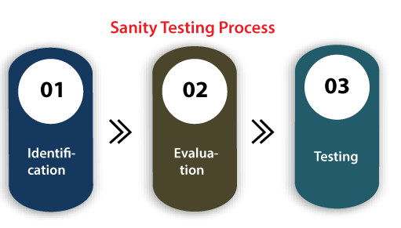

Slide 18
The first step in the sanity testing process is Identification, where we detect the newly added components and features as well as the modification presented in the code while fixing the bug
After completing the identification step, we will analyze newly implemented components, attributes and modify them to check their intended and appropriate working as per the given requirements.
Once the identification and evaluation step are successfully processed, we will move to the next step, which is testing.

Slide 19
Smoke Testing
Smoke Testing is a software testing technique performed post software build to verify that the critical functionalities of software are working fine.
The main purpose of smoke testing is to reject a software application with defects so that QA team does not waste time testing broken software application.

Slide 20
Smoke Testing checks the important functionality or component of the system.
The objective is not to perform exhaustive testing, but to verify that the critical functionalities of the system are working fine.
For Example, a typical smoke test would be – Verify that the application launches successfully, Check that the GUI is responsive … etc.

Slide 21
TEST PLAN

Slide 22
Test Plan
A test plan is a detailed document which describes software testing areas and activities.
It outlines the test strategy, objectives, test schedule, required resources (human resources, software, and hardware), test estimation and test deliverables
The test plan is a base of every software's testing. It is the most crucial activity which ensures availability of all the lists of planned activities in an appropriate sequence.

Slide 23
The test plan is a template for conducting software testing activities as a defined process that is fully monitored and controlled by the testing manager.
The test plan is prepared by the Test Lead (60%), Test Manager(20%), and by the test engineer(20%).

Slide 24
Types of Test Plan
Master Test Plan
Phase Test Plan
Testing Type Specific Test Plans

Slide 25
Master Test Plan
Master Test Plan is a type of test plan that has multiple levels of testing. It includes a complete test strategy.
Phase Test Plan
A phase test plan is a type of test plan that addresses any one phase of the testing strategy. For example, a list of tools, a list of test cases, etc.

Slide 26
Specific Test Plans
Specific test plan designed for major types of testing like security testing, load testing, performance testing, etc.
In other words, a specific test plan designed for non-functional testing.

Slide 27
How to write a Test Plan
First, analyze product structure and architecture.
Now design the test strategy.
Define all the test objectives.
Define the testing area.
Define all the useable resources.
Schedule all activities in an appropriate manner.
Determine all the Test Deliverable

Slide 28
Template
Template contains all the templates for the documents that will be used in the product, and all the test engineers will use only these templates in the project to maintain the consistency of the product.
we have different types of the template which are used during the entire testing process

Slide 29
Test case template
Test case review template
RTM Template
Bug Report Template
Test execution Report

Slide 30
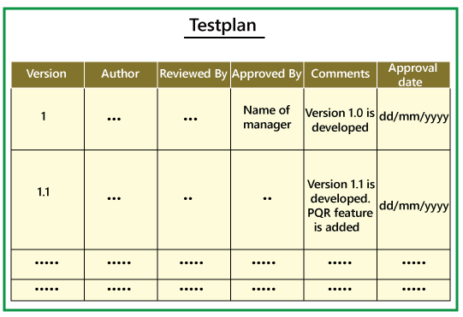
Sample of test plan document

Slide 31
we primarily fill only the Versions, Author, Comments, and Reviewed By fields, and after the manager approves it,
we will mention the details in the Approved By and Approval Date fields.

Slide 32
Note:
Who writes the test plan?
Test Lead→60%
Test Manager→20%
Test Engineer→20%
Therefore, as we can see from above that in 60% of the product, the test plan is written by the Test Lead.

Slide 33
Who reviews the Test Plan?
Test Lead
Test Manager
Test engineer
Customer
Development team

Slide 34
Who approve the test Plan?
Customer
Test Manager
Who writes the test case?
Test Lead
Test Engineer

Slide 35
Who review the test case?
Test Engineer
Test Lead
Customer
Development Team
Who approves the Test cases?
Test Manager
Test Lead
Customer

Slide 36
Importance of Test Plan
The test plan gives direction to our thinking. This is like a rule book, which must be followed.
The test plan helps in determining the necessary efforts to validate the quality of the software application under the test.
The test plan helps those people to understand the test details that are related to the outside like developers, business managers, customers, etc.

Slide 37
Important aspects like test schedule, test strategy, test scope etc are documented in the test plan so that the management team can review them and reuse them for other similar projects.

Slide 38
TESTNG LEVELS

Slide 39
Two significant/main levels of software testing
Functional Testing
Unit Testing
Integration Testing
System Testing
Regression Testing
Acceptance Testing
Non-functional Testing
Performance Testing
Load Testing
Stress Testing
Usability Testing
Security Testing
Portability Testing

Slide 40
Functional Testing
This is a kind of black box testing that is specification-oriented, which is done by putting the input, and then the output is examined whether it comes the way it is expected.
Five steps of testing are there, which involved the testing of an application for functionality

Slide 41
Determine the functionality which a projected software is meant to perform.
Creation of test data depending on the requirements of the application.
Check for output, depending on the data being tested along with the specifications of your application.
Scripting of scenarios by testing and then executing those test cases.
Compare the actual as well as expected output depending on the executed tests

Slide 42
Non-functional Testing
This type of testing deals with testing any product from the requirement point of view that is nonfunctional in type and important at the same time.
Nonfunctional testing can be categorized as:
Performance
Security
User interface

Slide 43
Unit Testing
This type of testing is performed by developers before the setup is handed over to the testing team to formally execute the test cases.
Unit testing is performed by the respective developers on the individual units of source code assigned areas.
The developers use test data that is different from the test data of the quality assurance team.
The goal of unit testing is to isolate each part of the program and show that individual parts are correct in terms of requirements and functionality.

Slide 44
Integration testing
Integration testing is defined as the testing of combined parts of an application to determine if they function correctly. Integration testing can be done in two ways: Bottom-up integration testing and Top-down integration testing
Bottom-up integration testing begins with unit testing, followed by tests of progressively higher-level combinations of units called modules or builds
Top-down integration testing, the highest-level modules are tested first and progressively, lower-level modules are tested thereafter.

Slide 45
System Testing
System testing tests the system as a whole.
Once all the components are integrated, the application as a whole is tested rigorously to see that it meets the specified Quality Standards.
This type of testing is performed by a specialized testing team.

Slide 46
Regression Testing
Whenever a change in a software application is made, it is quite possible that other areas within the application have been affected by this change.
Regression testing is performed to verify that a fixed bug hasn't resulted in another functionality.

Slide 47
Acceptance Testing
This is arguably the most important type of testing, as it is conducted by the Quality Assurance Team who will gauge whether the application meets the intended specifications and satisfies the client’s requirement.
The QA team will have a set of pre-written scenarios and test cases that will be used to test the application.

Slide 48
Non-Functional Testing
Non-functional testing involves testing a software from the requirements which are nonfunctional in nature but important such as performance, security, user interface, etc.

Slide 49
Performance Testing
It is mostly used to identify any bottlenecks or performance issues rather than finding bugs in a software. There are different causes that contribute in lowering the performance of a software
Network delay
Client-side processing
Database transaction processing
Load balancing between servers
Data rendering

Slide 50
Load Testing
It is a process of testing the behavior of a software by applying maximum load in terms of software accessing and manipulating large input data.
It can be done at both normal and peak load conditions. This type of testing identifies the maximum capacity of software and its behavior at peak time.
Most of the time, load testing is performed with the help of automated tools such as Load Runner, AppLoader, IBM Rational Performance Tester, Apache JMeter, Silk Performer, Visual Studio Load Test, etc.

Slide 51
Stress Testing
Stress testing includes testing the behavior of a software under abnormal conditions. For example, it may include taking away some resources or applying a load beyond the actual load limit.
The aim of stress testing is to test the software by applying the load to the system and taking over the resources used by the software to identify the breaking point.

Slide 52
Usability Testing
Usability testing is a black-box technique and is used to identify any error(s) and improvements in the software by observing the users through their usage and operation.
Security Testing
Security testing involves testing a software in order to identify any flaws and gaps from security and vulnerability point of view.

Slide 53
Portability Testing
Portability testing includes testing a software with the aim to ensure its reusability and that it can be moved from another software as well

Slide 54
BUGS

Slide 55
The Bug is the informal name of defects, which means that software or application is not working as per the requirement
A software bug can also be issue, error, fault, or failure. The bug occurred when developers made any mistake or error while developing the product.
While testing the application or executing the test cases, the test engineer may not get the expected result as per the requirement.

Slide 56
Basic terminology of defect
Defect
Bug
Error
Issue
Mistake
Failure

Slide 57
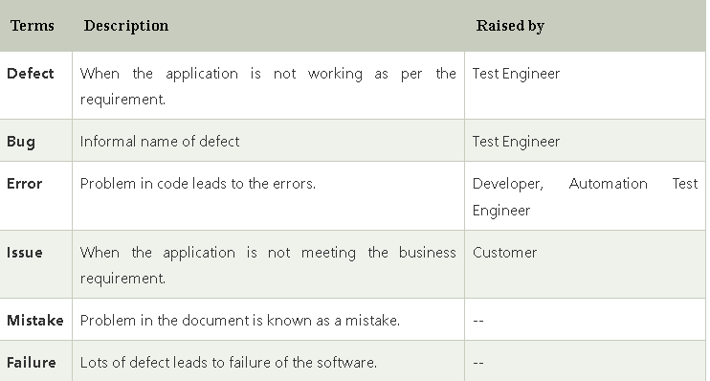

Slide 58
Why defect/bug occur?
Wrong coding
Wrong coding means improper implementation
For example: Suppose if we take the Gmail application where we click on the "Inbox" link, and it navigates to the “ Draft" page, this is happening because of the wrong coding which is done by the developer, that's why it is a bug.

Slide 59
Parameters of a Bug:
Date of issue, author, approvals and status.
Severity and priority of the incident.
The associated test case that revealed the problem
Expected and actual results.
Identification of the test item and environment.
Description of the incident with steps to Reproduce
Status of the incident
Conclusions, recommendations and approvals.

Slide 60
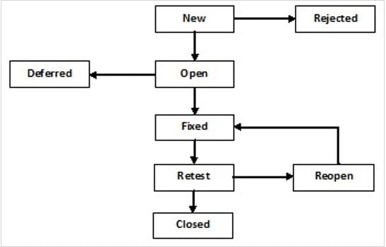
BUG LIFE CYCLE

Slide 61
New: This is the first state of a defect in the Defect Life Cycle. When any new defect is found, it falls in a ‘New’ state
Assigned: In this stage, a newly created defect is assigned to the development team to work on the defect. This is assigned by the project lead or the manager of the testing team to a developer
Open: Here, the developer starts the process of analyzing the defect and works on fixing it

Slide 62
Fixed: When the developer finishes the task of fixing a defect by making the required changes then he can mark the status of the defect as “Fixed”.
Pending Retest: After fixing the defect, the developer assigns the defect to the tester to retest the defect at their end, and until the tester works on retesting the defect, the state of the defect remains in “Pending Retest”.

Slide 63
Retest: At this point, the tester starts the task of retesting the defect to verify if the defect is fixed accurately by the developer as per the requirements or not
Reopen: If any issue persists in the defect, then it will be assigned to the developer again for testing and the status of the defect gets changed to ‘Reopen’

Slide 64
Verified: If the tester does not find any issue in the defect after being assigned to the developer for retesting and he feels that if the defect has been fixed accurately then the status of the defect gets assigned to ‘Verified’.
Closed: When the defect does not exist any longer, then the tester changes the status of the defect to “Closed”.

Slide 65
Missing coding
Missing coding means that the developer may not have developed the code only for that particular feature.
For example: if we take the above example and open the inbox link, we see that it is not there only, which means the feature is not developed only

Slide 66
Extra coding
Extra coding means that the developers develop the extra features, which are not required according to the client’s requirements.
Suppose we have one application form wherein the Name field, the First name, and Last name textbox are needed to develop according to the client's requirement.
But, the developers also develop the "Middle name" textbox, which is not needed according to the client’s requirements

Slide 67
Bug tracking tools
Jira
Bugzilla
Redmine
Mantis
Backlog

Slide 68
Bugzilla is important bug tracking tool, which is most widely used by many organizations to track the bugs.
Bugzilla is an open-source tool, which is used to help the customer, and the client to maintain the track of the bugs.
It is also used as a test management tool because, in this, we can easily link other test case management tools such as quality Centre, etc.

Slide 69
Bugzilla supports various operating systems such as Windows, Linux, and Mac.
Bugzilla has some features which help us to report the bug easily:
A bug can be list in multiple formats
Email notification controlled by user preferences.
Advanced searching capabilities
Excellent security
Time tracking

